Slide 1
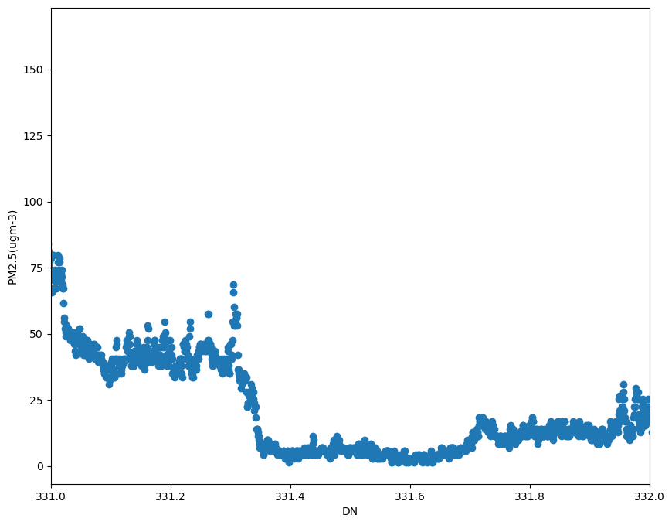
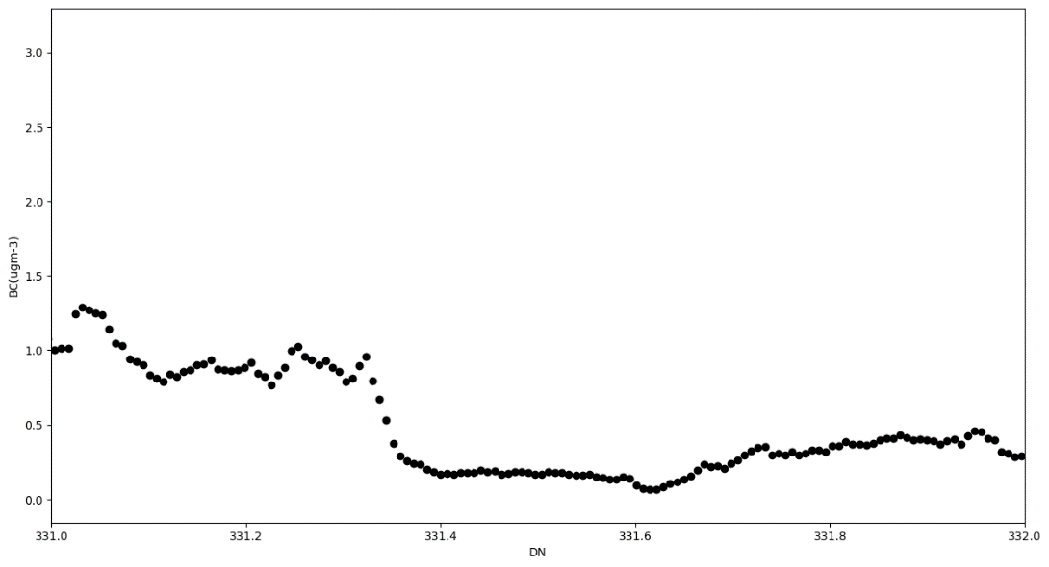
Time series of PM_{2.5} and BC
Nov. 27, 2022

